Slide 1


Graph Convolution Network approach for an efficient Bike Sharing System
Ashish Rawat
X18185801

Slide 2
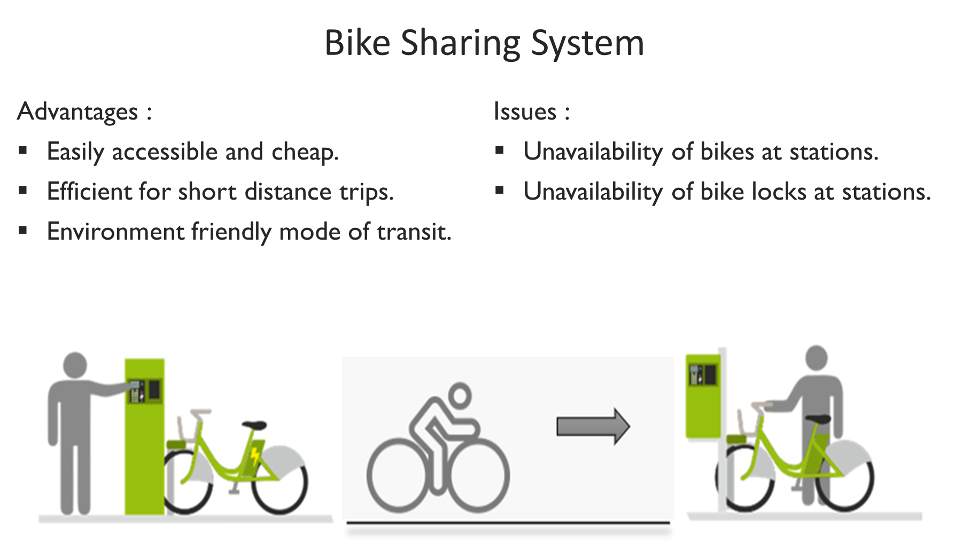

Slide 3

Current Solutions
Optimize truck routes.
Cluster based approach.
Bike demand forecasting model.

Slide 4
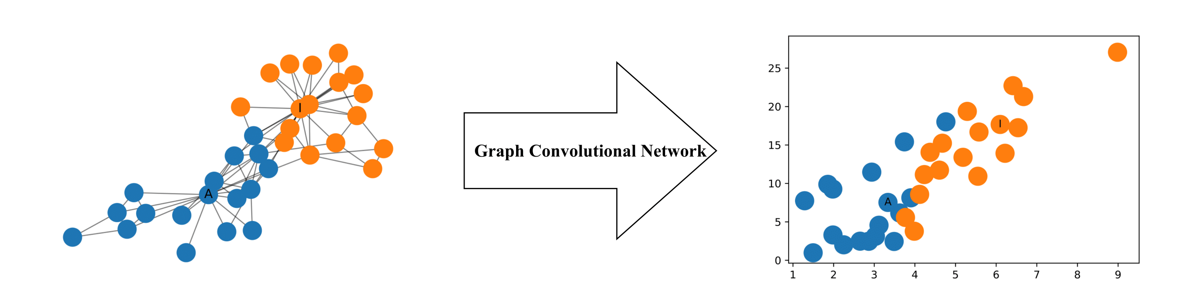
Graph Convolution Network
Operates on graph structured data.
Utilizes both temporal and spatial properties simultaneously.
Output is features extacted from graph network.

Slide 5
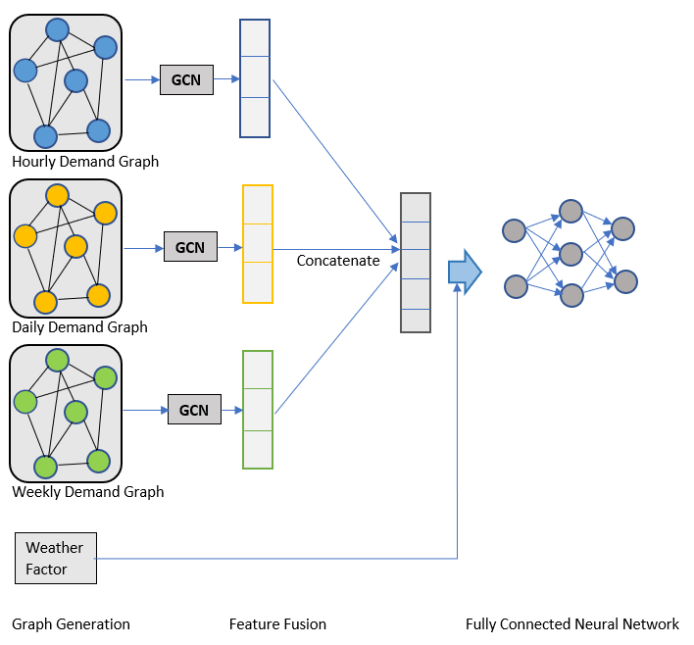
Framework

Slide 6
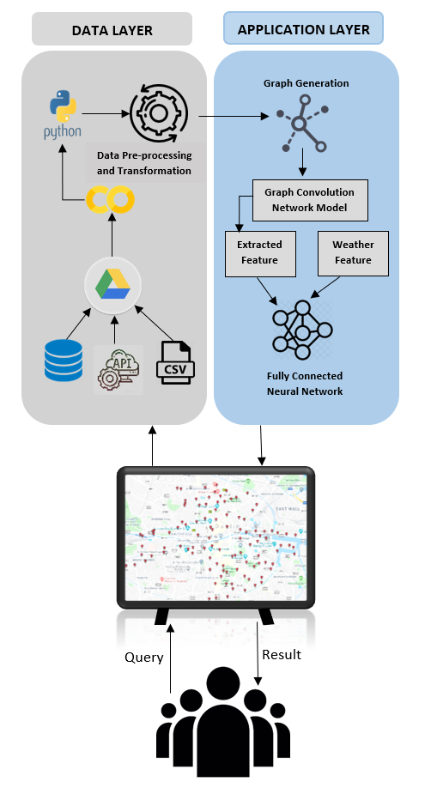
Design Specification
DublinBikes historic data:
SmartDublin (CSV file)
DublinBikes API
Open weather API

Slide 7
Conclusion
Accurately predicts the demand of bikes at each station.
The number of bikes and bike locks are increased or decreases accordingly.
Creation of new station and effective bike network expansion.

Slide 8
Thank You

